Slide 1
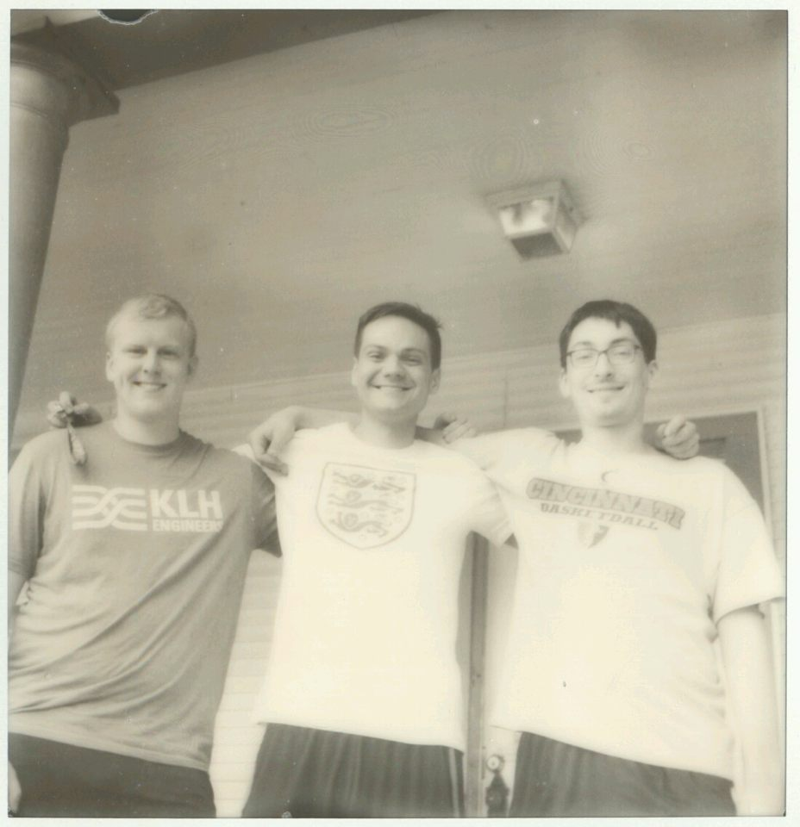



Team Members: Adam Kowalski, Will Severson, Andrew Kump, Christian Davidson
Advisor: Nan Niu

Slide 2
Goals
Create a page where UC students are able to login to the website.
Implement an inventory system to track item stock using barcodes and item names.
Develop a shopping cart system were students can add inventory to their unique shopping cart as well as complete a checkout.
Design a system to email users as well as pantry volunteers upon completion of an order. The email should contain a QR code which can be scanned to verify an orders information

Slide 3
Intellectual Merits
Food pantries are an important resource that allow students in universities across the country access to food, toiletries, and other necessities they might otherwise not be able to afford. Despite this fact, there are currently no universities in the united states utilizing an online inventory and order creation system similar to what you might find on eCommerce sites like Amazon.
Adapting these systems to the food pantry will allow for more efficient management of the pantry as well as provide a more convenient and anonymous means for students to access the pantry in a way not currently possible.

Slide 4
Broader Impacts
Making the pantry checkout systems more accessible to users increases the likelihood that those who actually need its resources most will have access to it.
Likewise, increasing the efficiency of the inventory management system means better use of volunteer time. Time spent manually tracking items can now be spent on improving other aspects of the pantry.

Slide 5
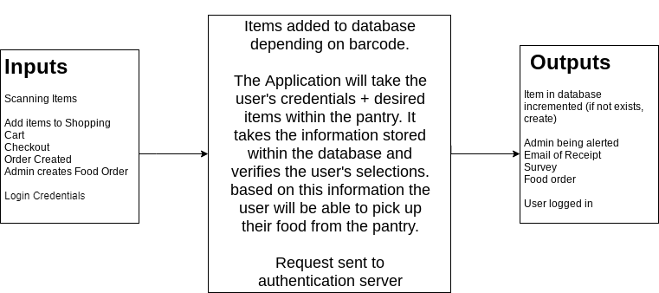
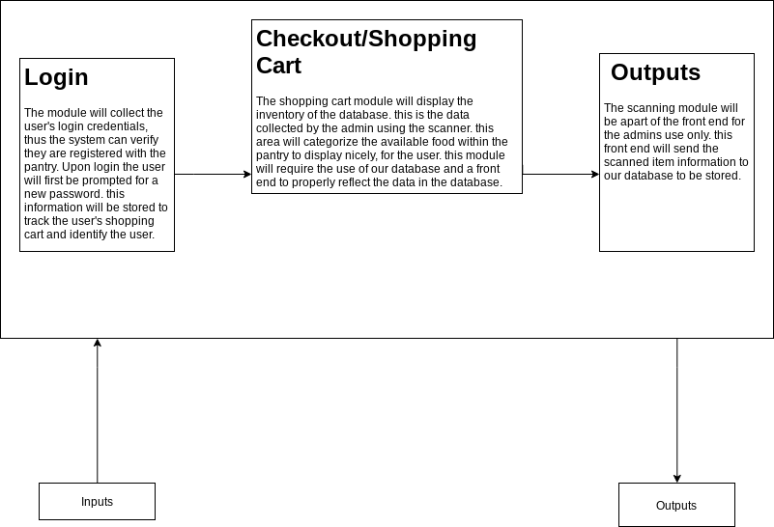
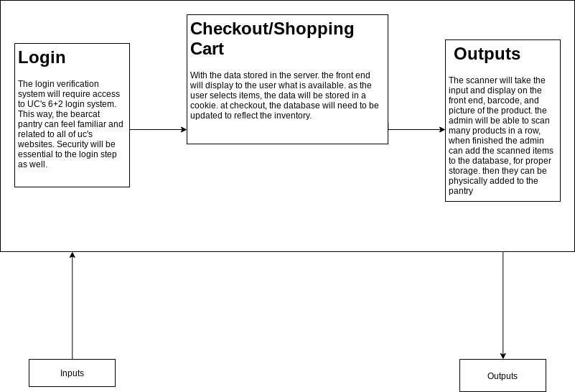
Design Specifications

Slide 6
Technologies
Node.JS
Bootswatch
Handlebars.js
Mongoose
Express
MongoDB
JQuery
Github
HTML
CSS

Slide 7
Milestones
Develop form for student worker to use barcode scanner to scan items into the database. If a barcode has not been seen before, prompt the worker to enter basic information about the scanned item. - 1/31/19
Look into using the University of Cincinnati’s authentication system within the website. - 4/20/19
Design website interface to meet the University standards. - 1/31/19
Develop shopping cart system to allow the students to choose and checkout inventory from the website. - 2/28/19
Develop a login system for administrators and students. - 4/20/19
Investigate site and database security. - 4/20/19
Design a notification system to alert bearcat pantry workers when a student has checked out items. - 2/28/19
Develop a way to send a receipt and survey message to student upon completion of checkout. - 2/28/19
Design basic administrator tools to limit the number of items a student can check out among other things. - 3/31/19
Develop system to collect and manage pantry checkout data. - 3/31/19
Implement system to email student when their order is ready: once a student worker has prepared the order, they can click a button to email the student. - 3/31/19
Testing of the entire system will need to be done by a team-member. - 4/20/19

Slide 8
Results
Working barcode scanning and inventory system.
Paginated browse page for users to select items from pantry stock.
Complete email verification system that sends an email once checkout has completed on the shopping cart page.
Admin tools, such as editing of existing items, added and visible only when logged in as admin.
Work In Progress
The log-in system still needs to be completed.
Image Caching
Testing
Improve website Home Page
Improve email verification sent to bearcat pantry email.
Change user order email to allow for link input.

Slide 9
Challenges
Predicting edge cases to prevent unintended website behavior.
Ex: Uploading an .EXE file as the image for an item in the pantry.
Communicating between development team and university.
Inexperience using mongoDB and javascript.
Developing an effective user interface with minimal input from university.

